Slide 1
SQL Joins
Submitted By
Maimoona Khilji

Slide 2
SQL JOIN
A “Join” clause is used to combine rows from two or more tables, based on a related column between them.

Slide 3
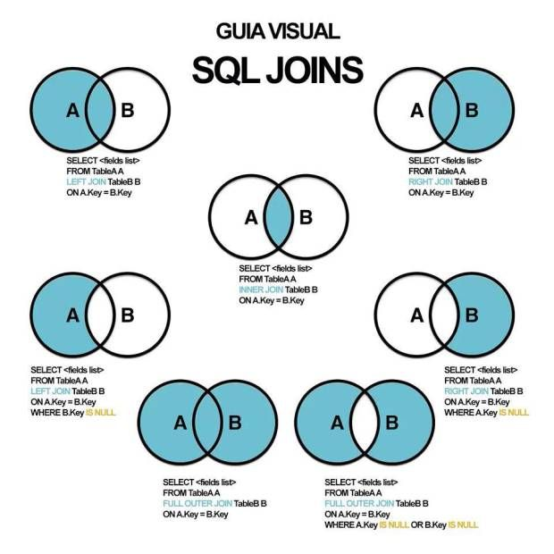
Types of Joins
Natural joins:
NATURAL JOIN clause
USING clause
ON clause
Outer joins:
LEFT OUTER JOIN
RIGHT OUTER JOIN
FULL OUTER JOIN
Cross joins

Slide 4
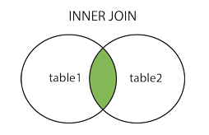
INNER JOIN
The INNER JOIN keyword selects records that have matching values in both tables.
Syntax:
SELECT column_name(s) FROM table1 INNER JOIN table2 ON table1.column_name = table2.column_name;

Slide 5
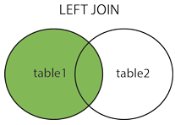
LEFT JOIN
The LEFT JOIN keyword returns all records from the left table (table1), and the matching records from the right table (table2). The result is 0 records from the right side, if there is no match.
Syntax:
SELECT column_name(s) FROM table1 LEFT JOIN table2 ON table1.column_name = table2.column_name;

Slide 6
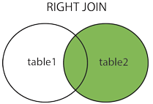
RIGHT JOIN
The RIGHT JOIN keyword returns all records from the right table (table2), and the matching records from the left table (table1). The result is 0 records from the left side, if there is no match.
Syntax:
SELECT column_name(s) FROM table1 RIGHT JOIN table2 ON table1.column_name = table2.column_name;

Slide 7
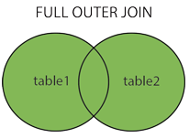
FULL OUTER JOIN
The FULL OUTER JOIN keyword returns all records when there is a match in left (table1) or right (table2) table records.
Syntax:
SELECT column_name(s) FROM table1 RIGHT JOIN table2 ON table1.column_name = table2.column_name;

Slide 8
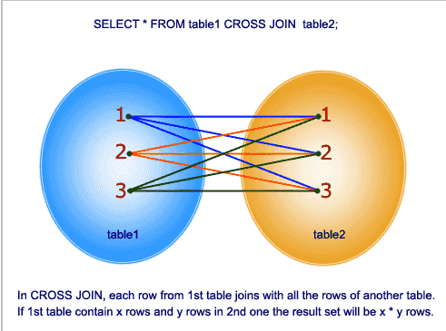
CROSS JOIN
The SQL CROSS JOIN produces a result set which is the number of rows in the first table multiplied by the number of rows in the second table if no WHERE clause is used along with CROSS JOIN. This kind of result is called as Cartesian Product.
If WHERE clause is used with CROSS JOIN, it functions like an INNER JOIN.
Syntax:
SELECT *
FROM table1
CROSS JOIN table2;

Slide 9
Difference between Natural Joins, Using, and ON Join
Natural Joins | Using Clause | ON Clause
It is used to join two tables on the basis of identical columns that have same names and same data types | It is used to join two tables on the basis of multiple columns with same name | It is used to join two tables on the basis of columns that have different names.

Slide 10
Natural Joins
The NATURAL JOIN clause is based on all columns in the two tables that have the same name.
It selects rows from the two tables that have identical column names and data types.
If the columns having the same names have different data types, an error is returned.
Syntax:
SELECT Table1.column, Table2.column
FROM Table1
NATURAL JOIN Table2 ;

Slide 11
Creating Joins with the USING Clause
If several columns have the same names but the data types do not match, natural join can be applied using the USING clause to specify the columns that should be used for an equijoin.
Use the USING clause to match only one column when more than one column matches.
The NATURAL JOIN and USING clauses are mutually exclusive.
Syntax:
SELECT Table1.column, Table2.column
FROM Table1
JOIN Table2
USING join_column;

Slide 12
Creating Joins with the ON Clause
The join condition for the natural join is basically an equijoin of all columns with the same name.
Use the ON clause to specify arbitrary conditions or specify columns to join.
The join condition is separated from other search conditions.
The ON clause makes code easy to understand.
Syntax:
SELECT Table1.column, Table2.column
FROM Table1
JOIN Table2
ON ( Table1.column_name = Table2.column_name ) ;

Slide 13
Applying Additional Conditions
to a Join
Use the AND clause or the WHERE clause to apply additional conditions
Syntax:
SELECT Table1.column, Table2.column
FROM Table1
JOIN Table2
ON ( Table1.column_name = Table2.column_name )
AND [condition] ;
Syntax:
SELECT Table1.column, Table2.column
FROM Table1
JOIN Table2
ON ( Table1.column_name = Table2.column_name )
WHERE [condition] ;

Slide 14
SQL Self Join
A self join is a regular join, but the table is joined with itself.
Syntax:
SELECT column_name(s) FROM table1 T1, table1 T2 WHERE condition;

Slide 15
The SQL UNION
The UNION operator is used to combine the result-set of two or more SELECT statements.
Every SELECT statement within UNION must have the same number of columns
The columns must also have similar data types
The columns in every SELECT statement must also be in the same order
Syntax:
SELECT column_name(s) FROM table1 UNION SELECT column_name(s) FROM table2;
Notes:
UNION Syntax

Slide 16
UNION ALL
The UNION operator selects only distinct values by default. To allow duplicate values, use UNION ALL.
Syntax
SELECT column_name(s) FROM table1 UNION ALL SELECT column_name(s) FROM table2;

Slide 17
Key Points
Join => Combine rows on the basis of column
Inner join => Select records that are common in both tables
Left join => Select all record from left + common in right table
Right join => Select all record from right + common in left table
Full outer join => Select all records from both table including unmatched records
Cross join => Cartesian product of two tables
Natural Join
Natural join => Join tables on the basis of identical columns that have same names and same data types
Using clause => Join tables when several columns have same name and different data types
On clause => Join tables by specifying a column when columns have different names.
Condition with and & where.

Slide 18
Key Points
Condition with and & where.
Self join => Join the table to itself.
Union => Combine the result-set of two or more SELECT statements.
Union all => return duplicate values in union.
Notes:
Join
Inner join
Left join
Right join
Full outer join
Cross join
Natural Join
Natural join
Using clause
On clause
Condition with and & where.
Self join
Union
Union all

Slide 19
Questions
What is a join condition?
It defines that records from two tables can be combined by specifying column or logical operator.
Can we use any other operator other than “=“?
Yes, we can. Joins with other operators are known as non-equijoin.
Any join in which we don’t use “ON” clause?
Cross join. As it returns Cartesian product of tables.

Slide 20
THE END

